Slide 1


Cleckhuddersfax Online Mart
Project Management (Team Default)

Slide 2
Kritika Koirala
Anish Ghimire
Ayush Pant
Mohammad Farhan
Phurbu Choden Lama

Slide 3
Wip Presentation Summary
Project Charter
Project Contract
Belbin Analysis
Requirement
MS-Project
Implementation and Coding

Slide 4
Overview
CleckHuddersfax Online Mart is an internet business site which will be made so as to settle the present market emergency for the nearby retailers at Cleckhuddersfax. With the online market blossoming all around the world, Cleckhuddersfax is no more interesting to its impact on the neighborhood advertise and physical outlets. Chfonlinemart.com will be the response to handle the present issue and furnish the nearby retailers with an online stage for the retailing of their merchandise.

Slide 5
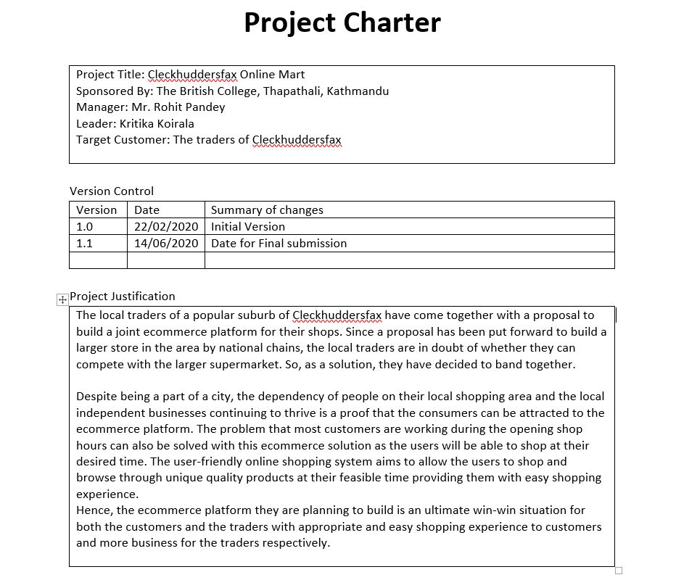
Project Charter

Slide 6
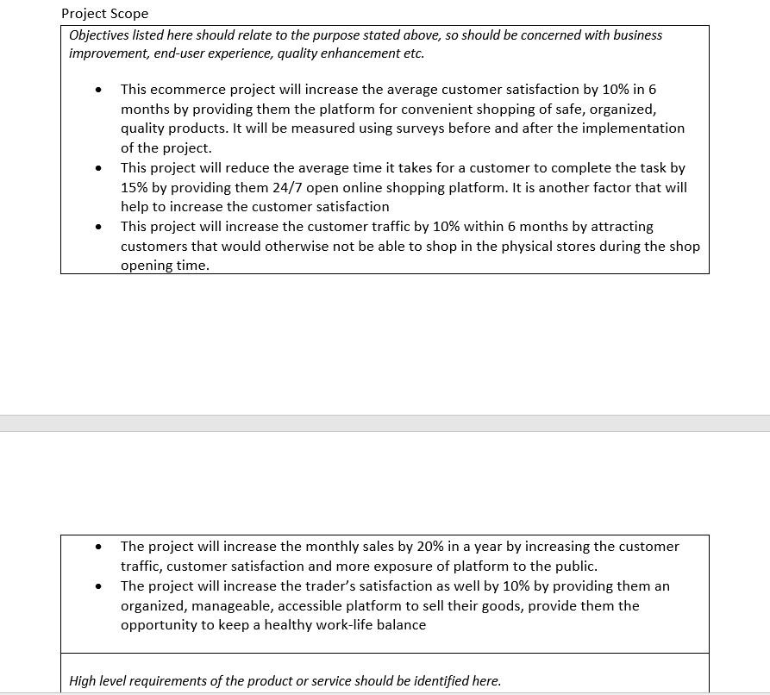
Project Charter

Slide 7
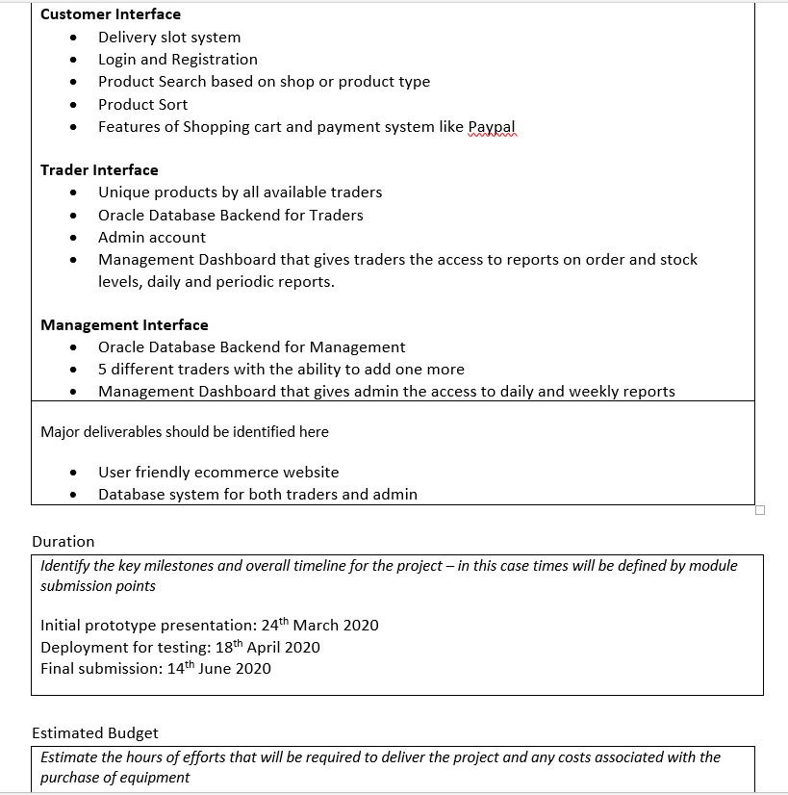
Project Charter

Slide 8
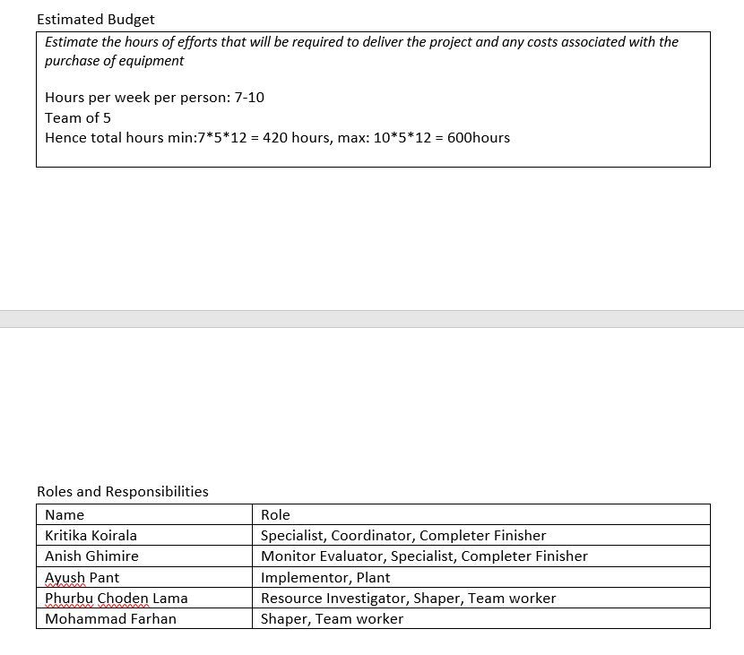
Project Charter

Slide 9
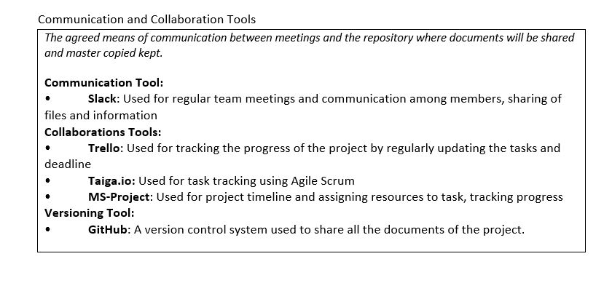
Project Charter

Slide 10
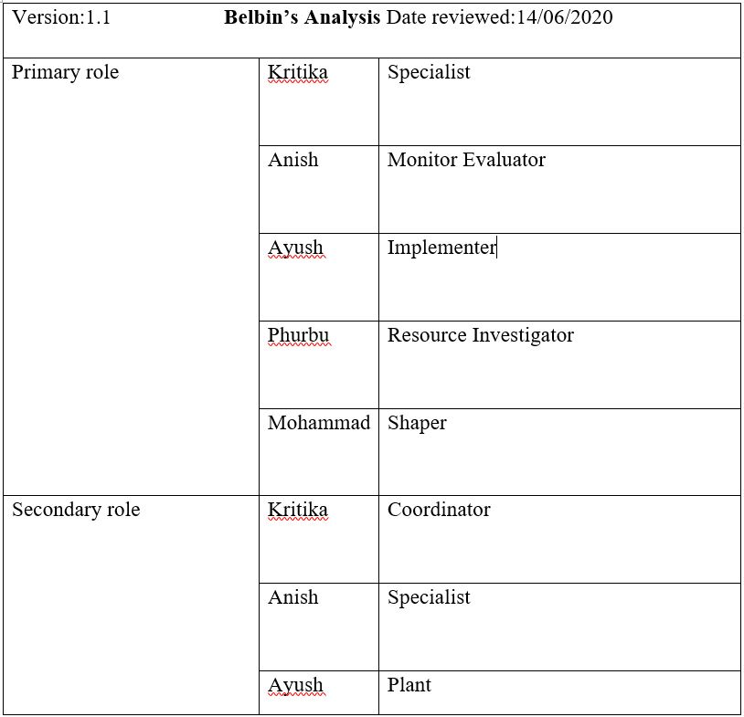
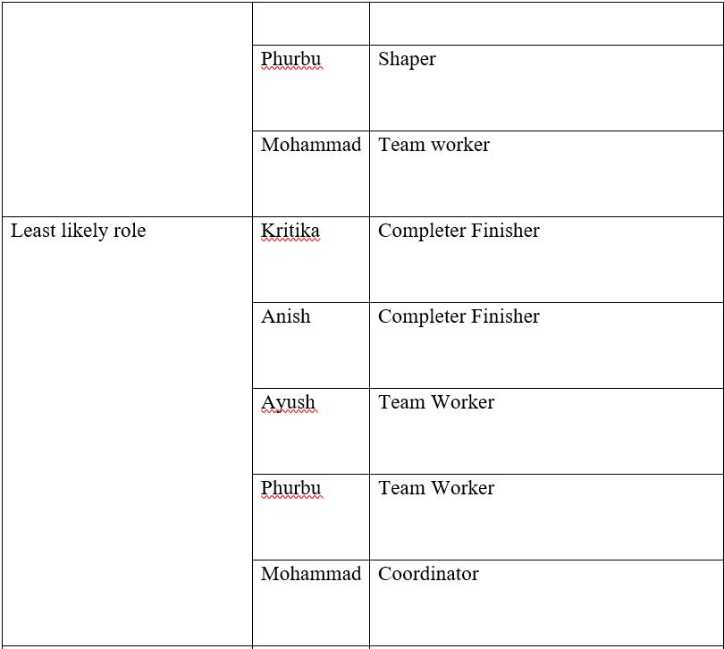
Belbin Analysis

Slide 11



Methodology
Oracle11g XE
XAMPP
Vscode
InstantClient 18.5

Slide 12
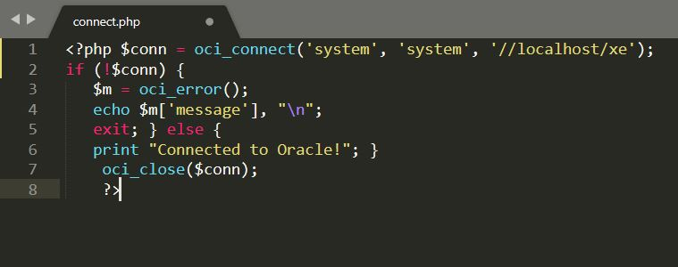
Connecting Database

Slide 13
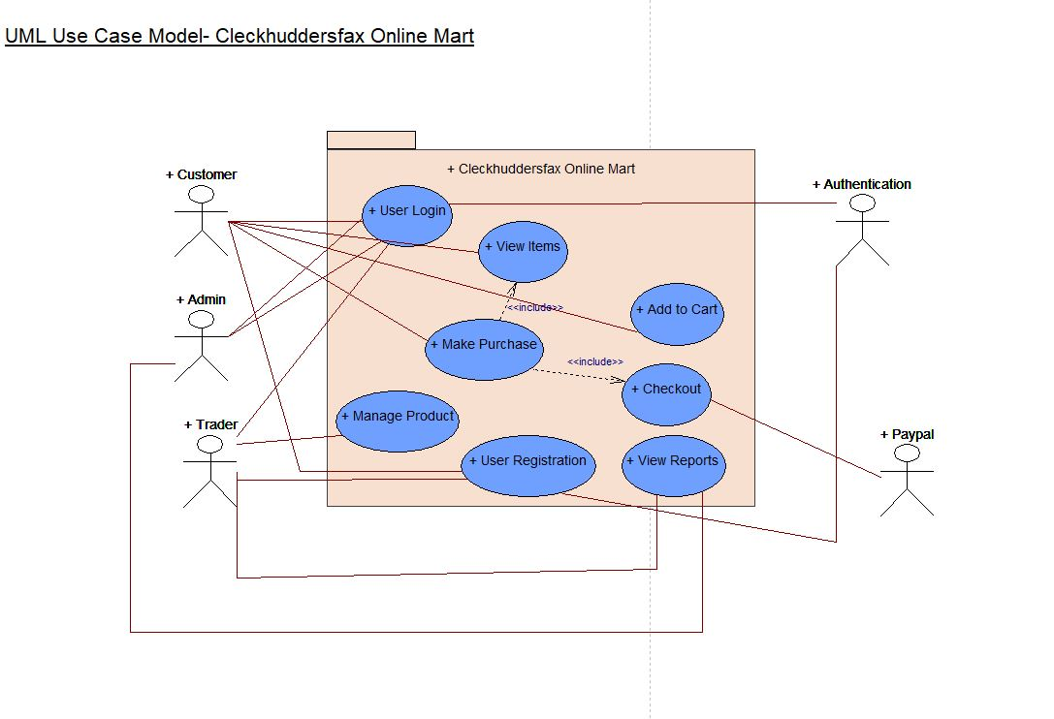
Conceptual Design

Slide 14
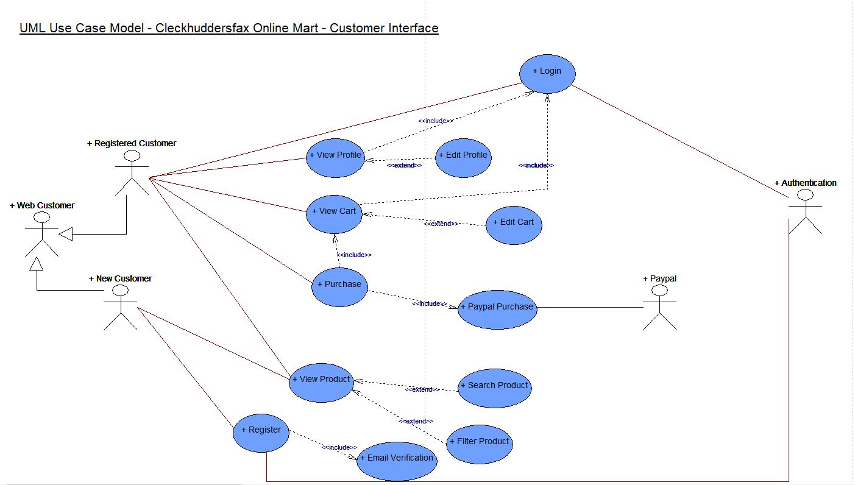
(Customer) Use case Diagram

Slide 15
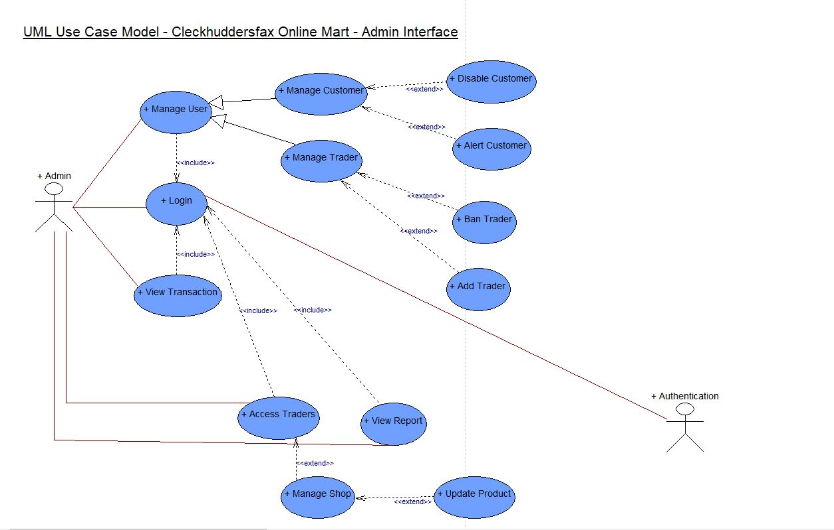
(Admin) Use case Diagram

Slide 16
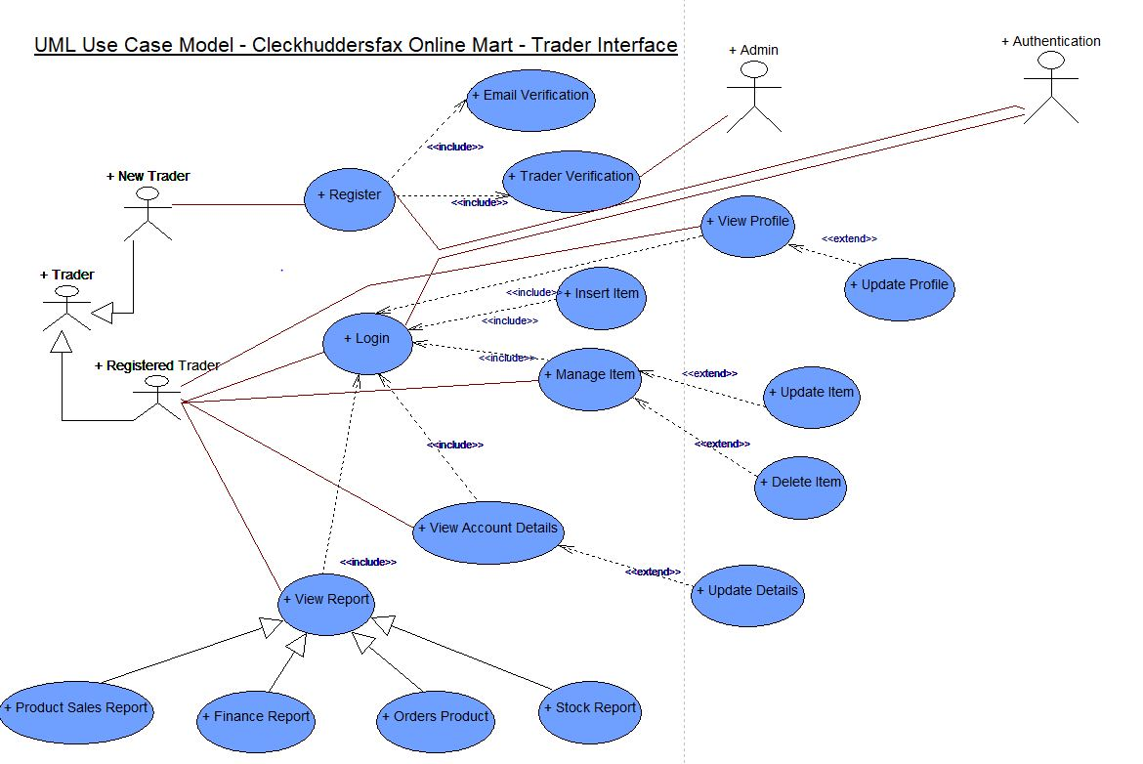
(Trader) Use case Diagram

Slide 17
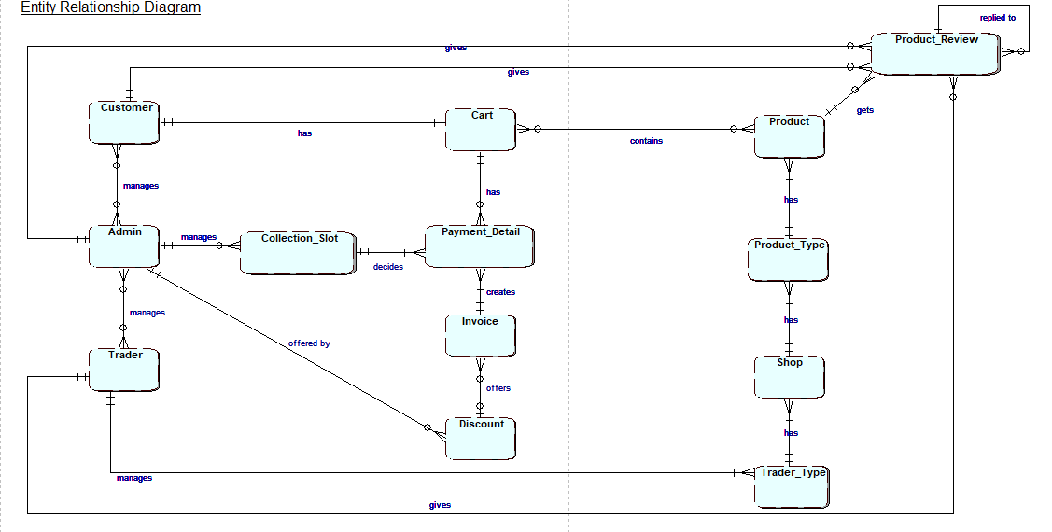
Entity Relationship Diagram

Slide 18
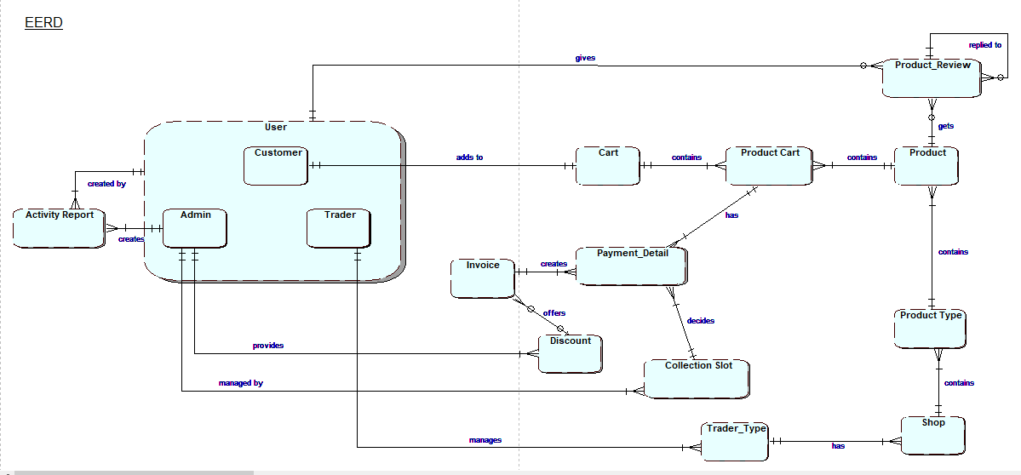
Extended Entity Relationship Diagram

Slide 19
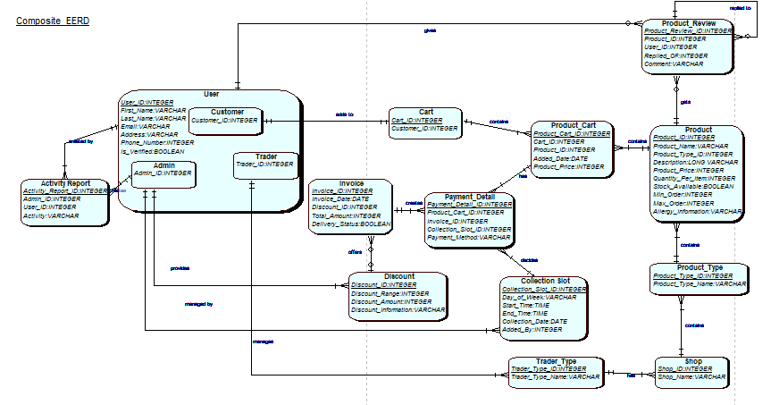
Composite Diagram

Slide 20
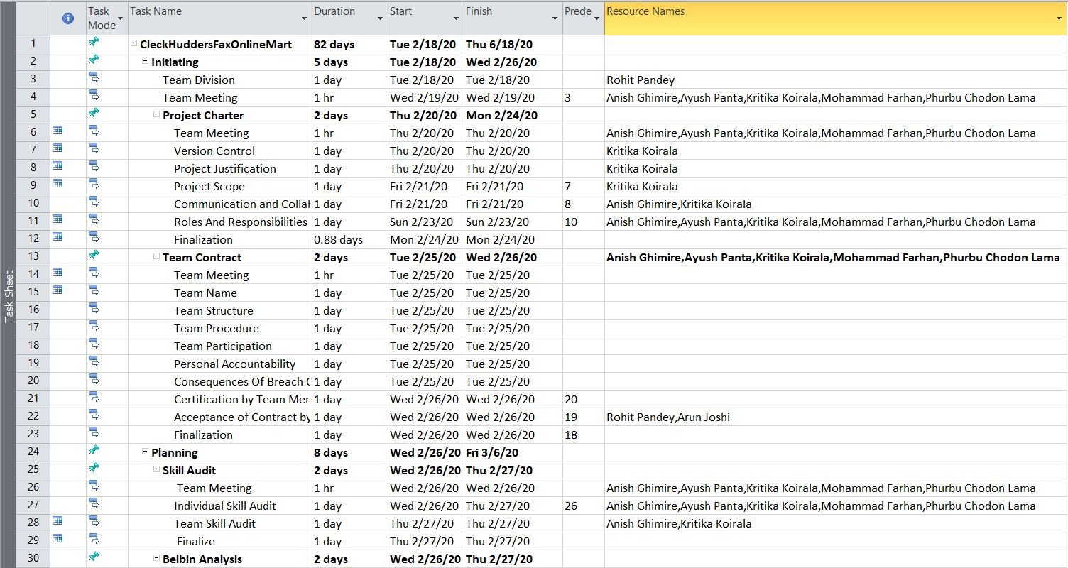
MS-Project (Task Sheet)

Slide 21
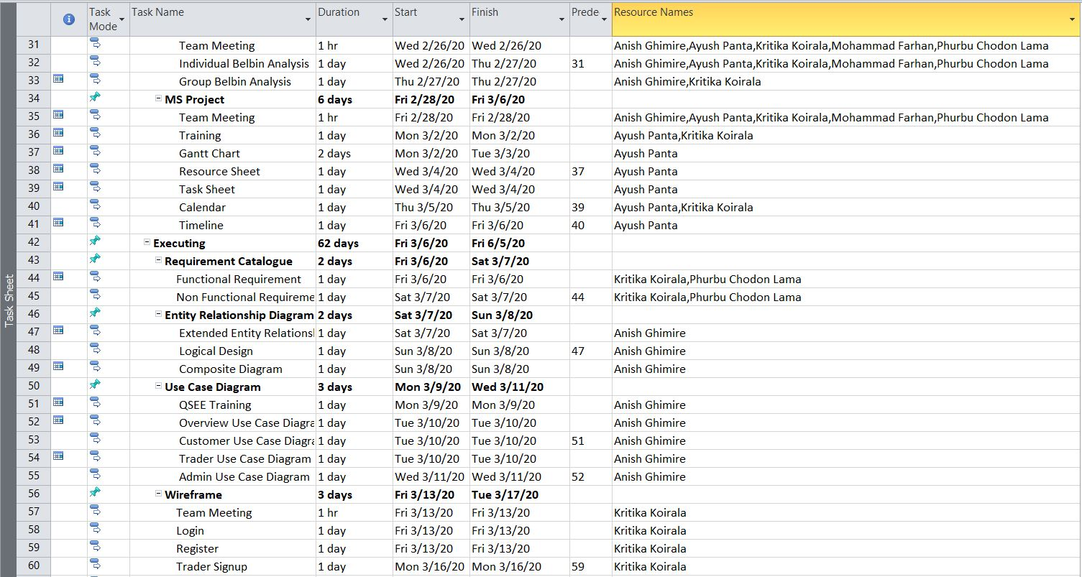
MS-Project (Task Sheet)

Slide 22
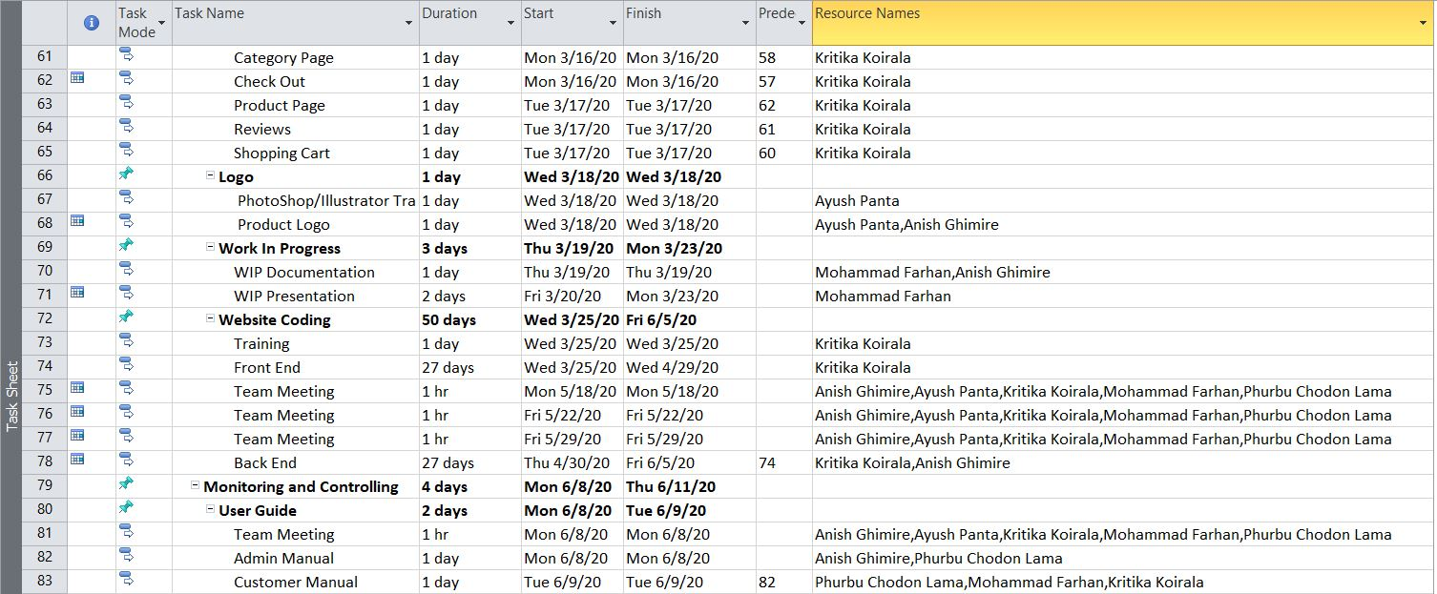
MS-Project (Task Sheet)

Slide 23
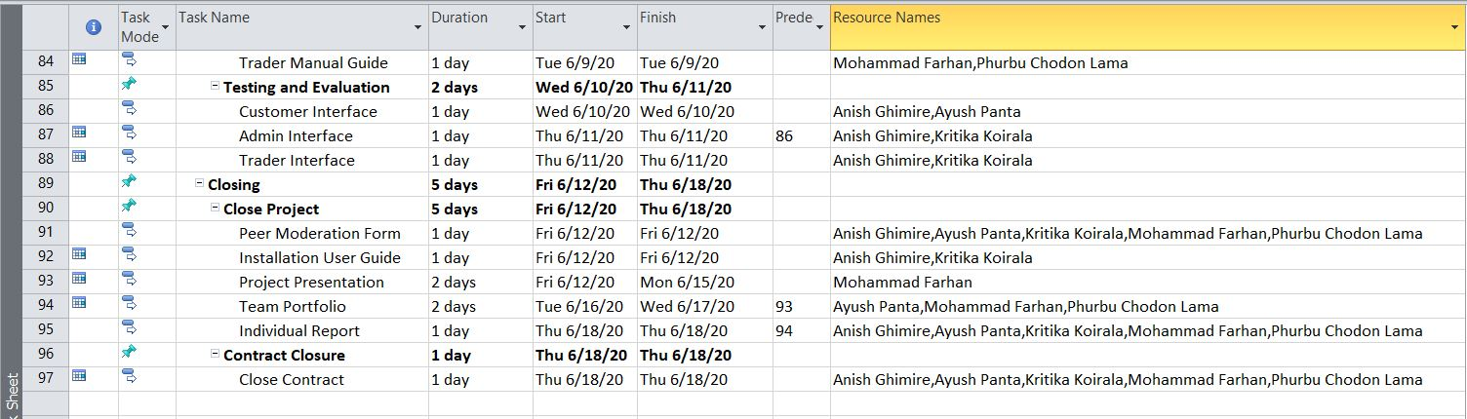
MS-Project (Task Sheet)

Slide 24
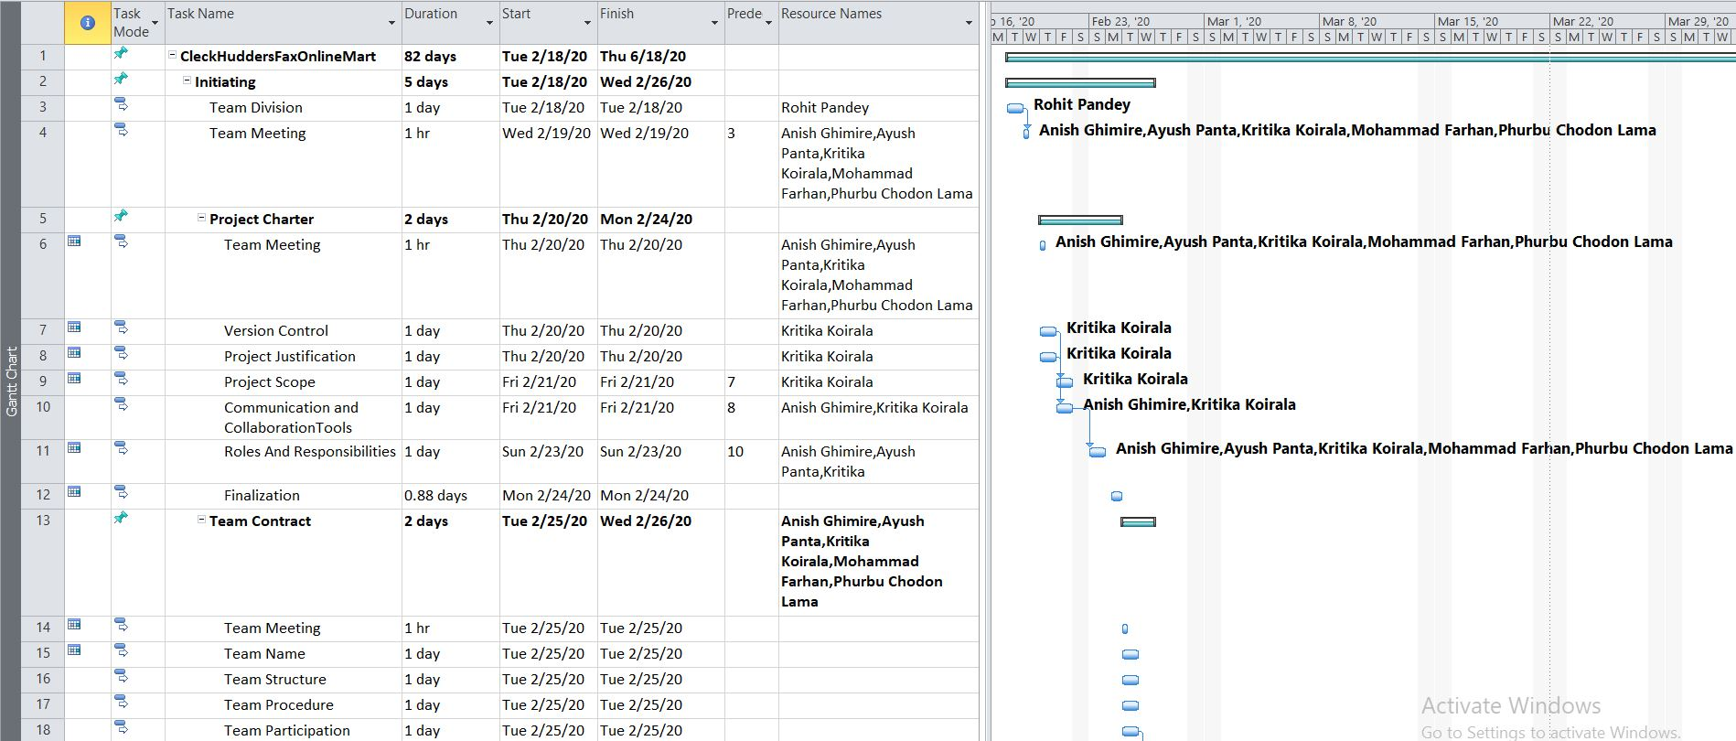
MS-Project (Gantt Chart)

Slide 25
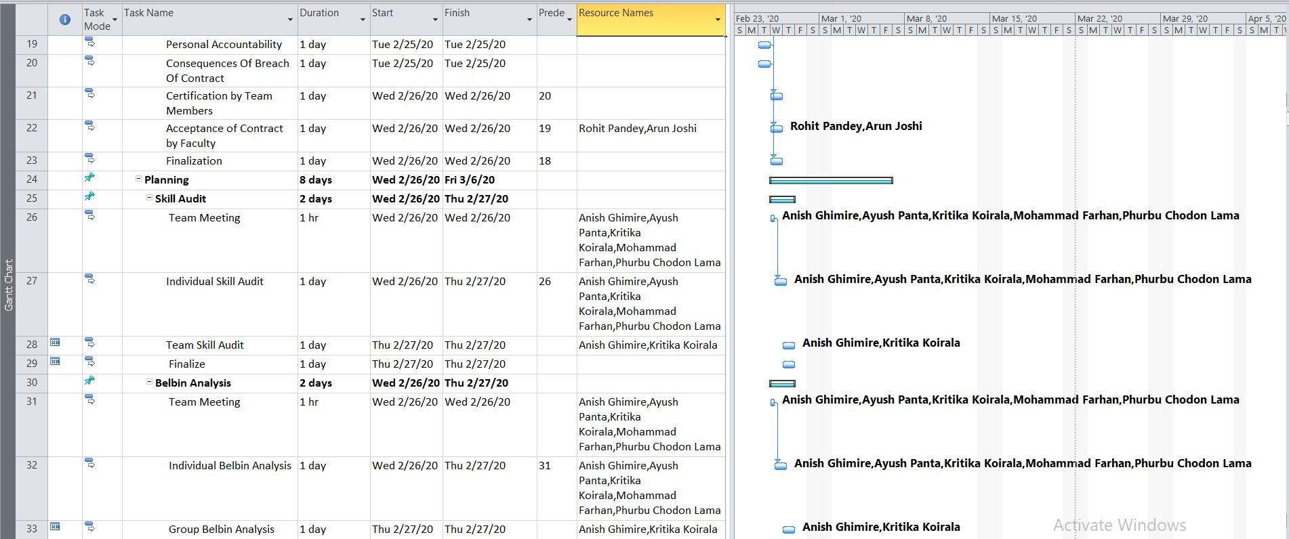
MS-Project (Gantt Chart)

Slide 26
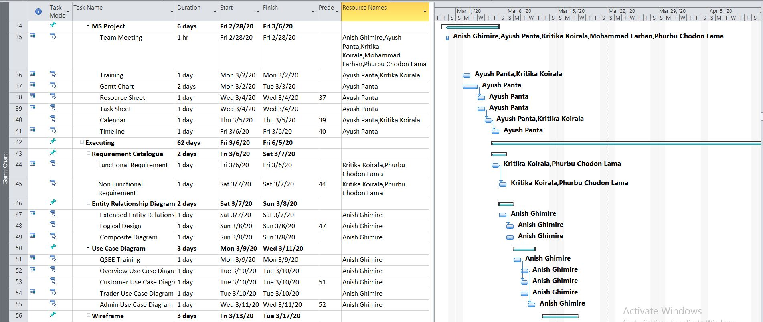
MS-Project (Gantt Chart)

Slide 27
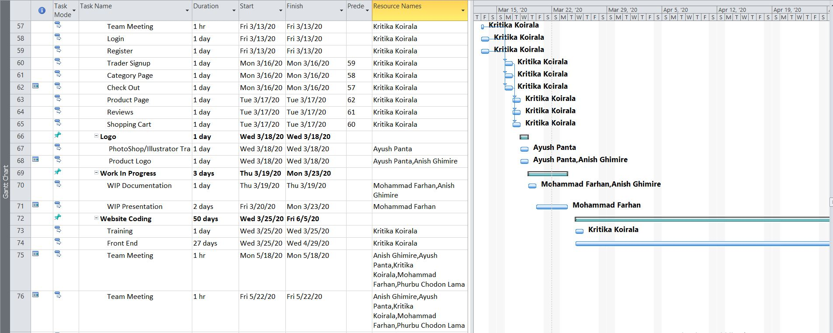
MS-Project (Gantt Chart)

Slide 28
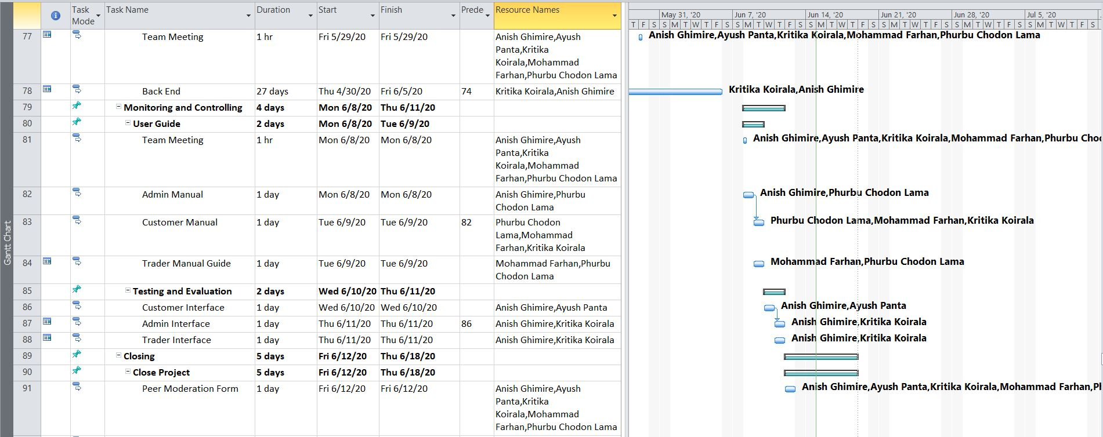
MS-Project (Gantt Chart)

Slide 29
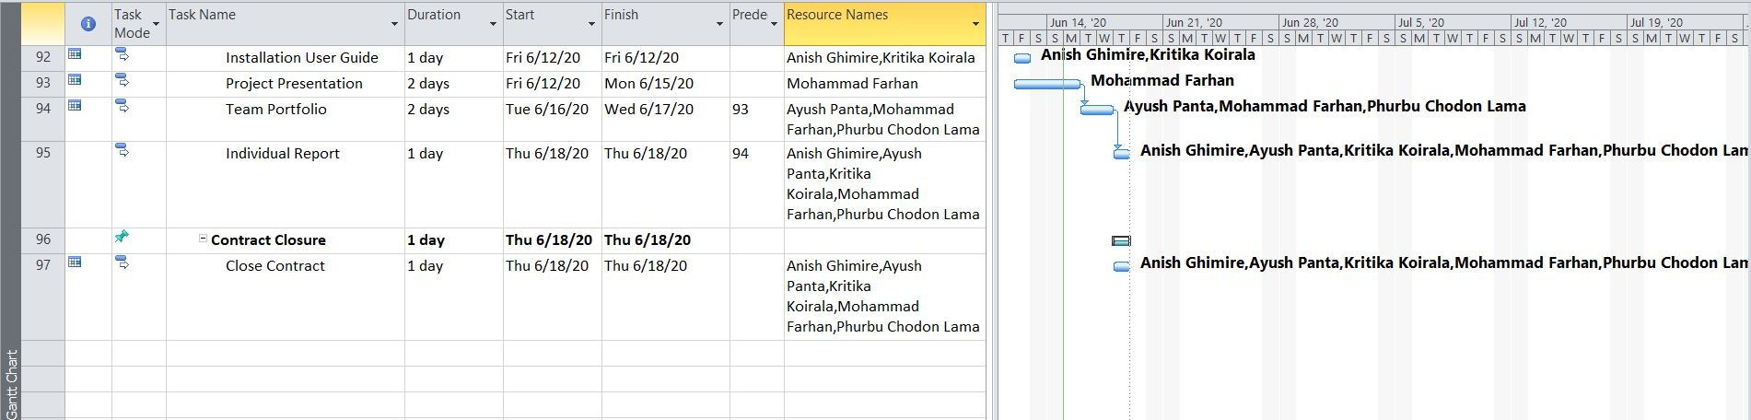
MS-Project (Gantt Chart)

Slide 30
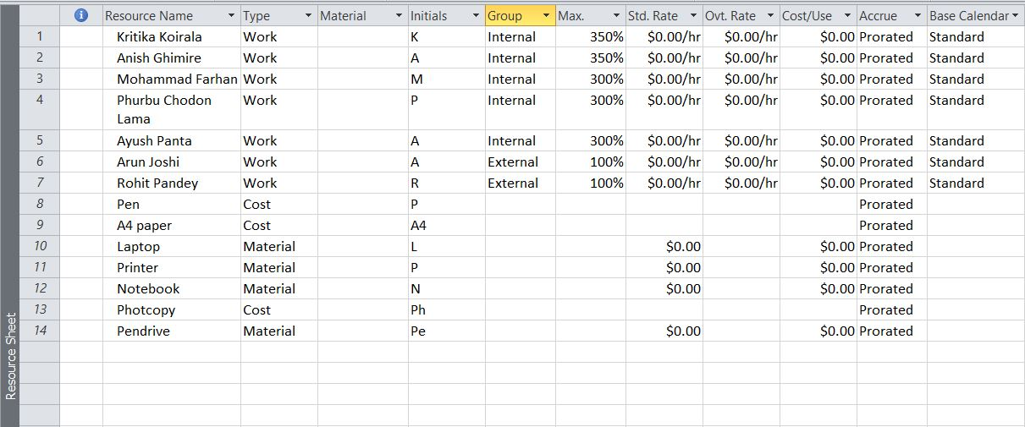
MS-Project (Resource Sheet)

Slide 31
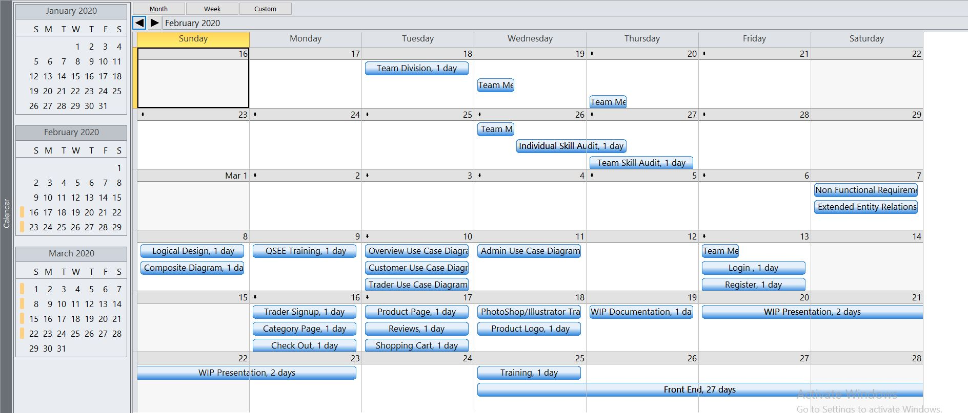
Calendar – February/March 2020

Slide 32
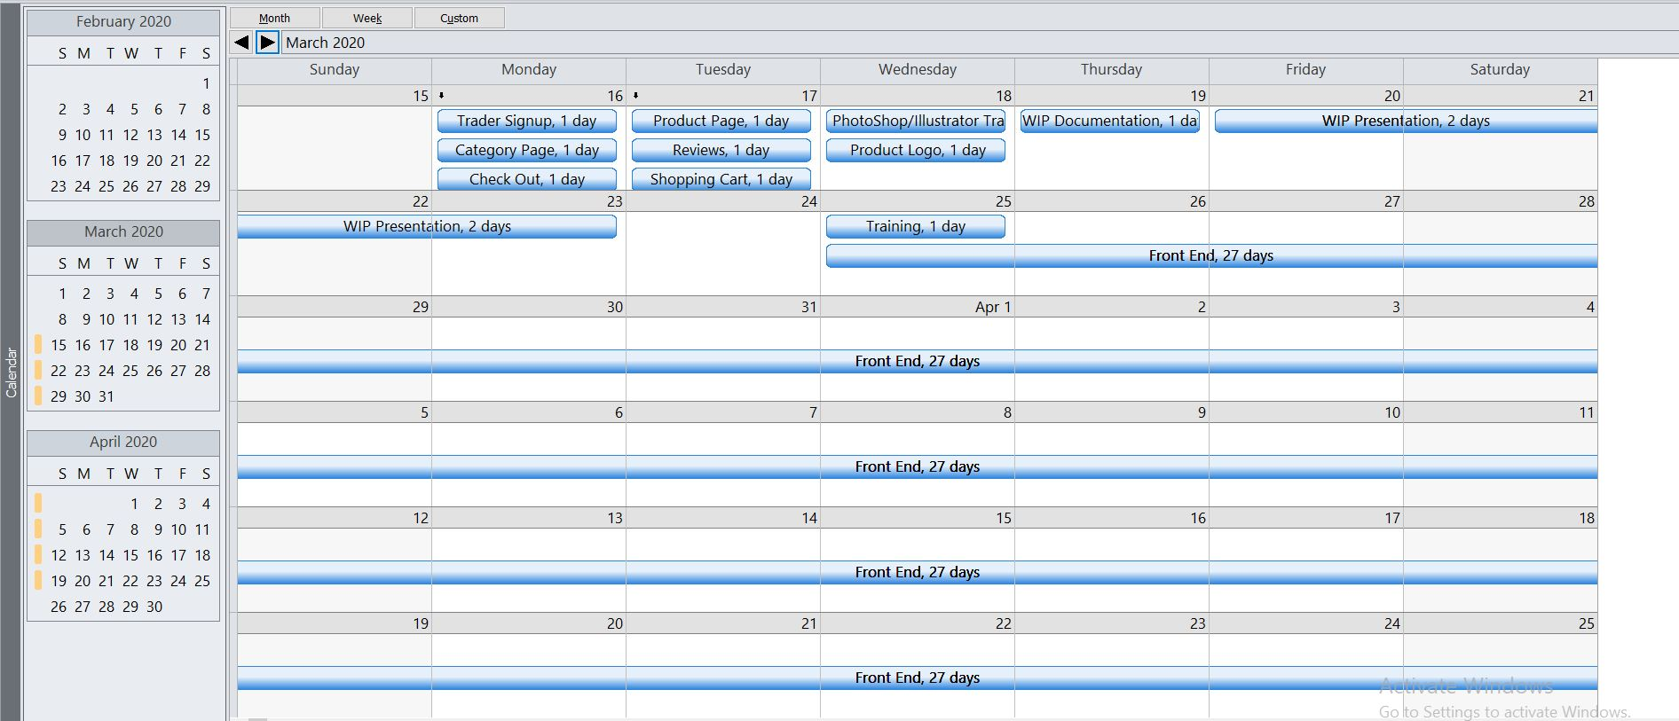
Calendar – March/April 2020

Slide 33
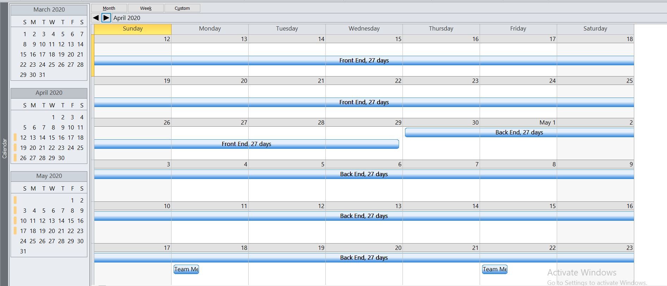
Calendar – April/May 2020

Slide 34
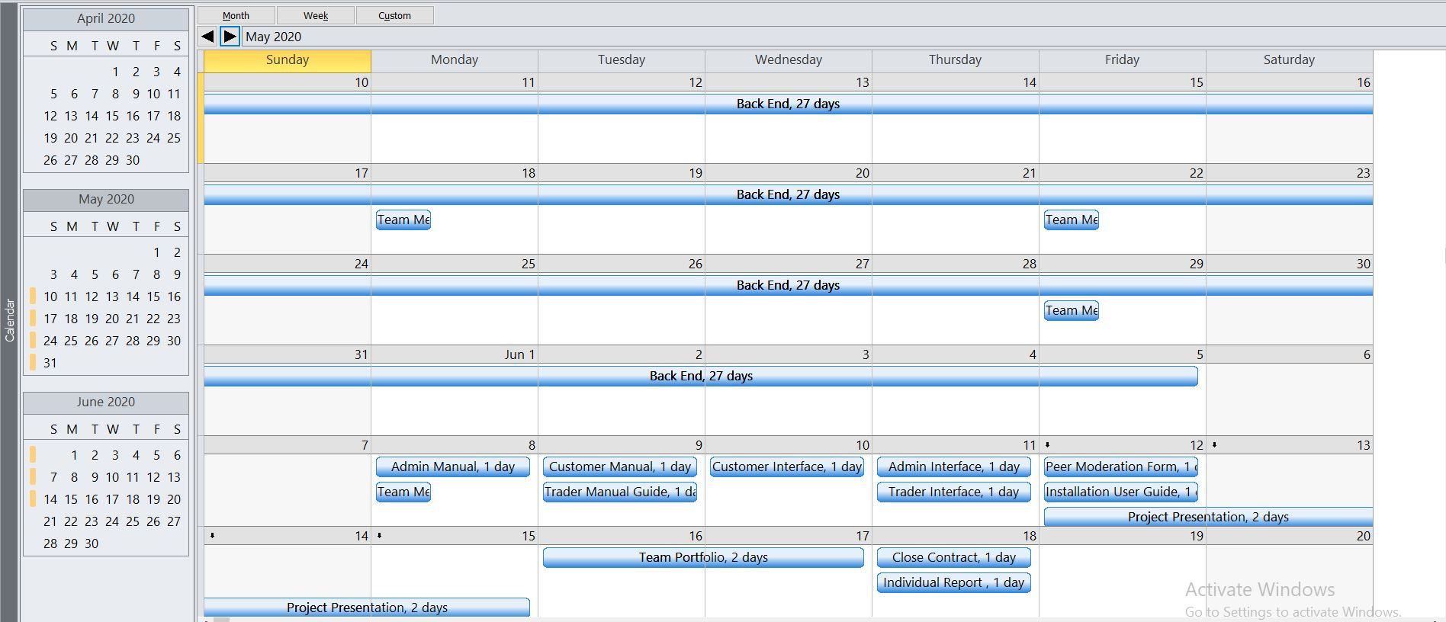
Calendar – May/June 2020

Slide 35
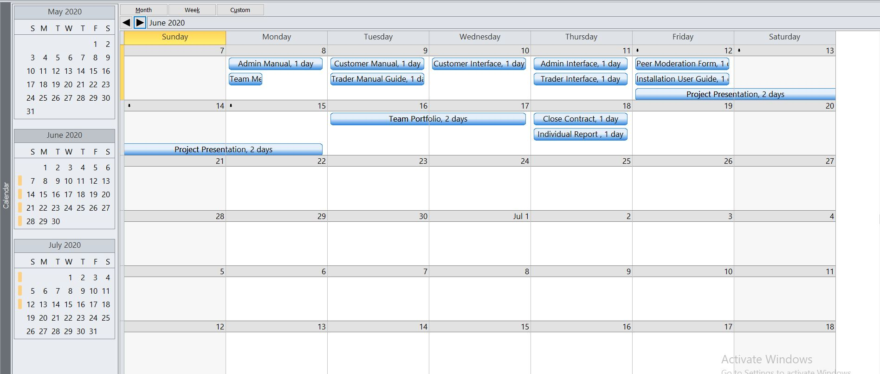
Calendar – June 2020

Slide 36
Webpage (User/Customer)
Home
Search
Offer/ Product
Check Out
Login/Register
Add To Cart

Slide 37
Webpage (Trader)
Dashboard
Add Shop
Add Product
Sell Product

Slide 38
Webpage (Admin)
Dashboard
Manage Shop
Manage Product
Manage Trader
Manage User

Slide 39
Website Demonstration

